Slide 1
A brilliant title

Slide 2
Here’s the title for the first slide
This is an unusually deeply nested list
Of bullets
And more bullets
And even more
And yes, yet more
One more super crazy deep one!
Back a level
Back to the first level
No bulleting at all

Slide 3
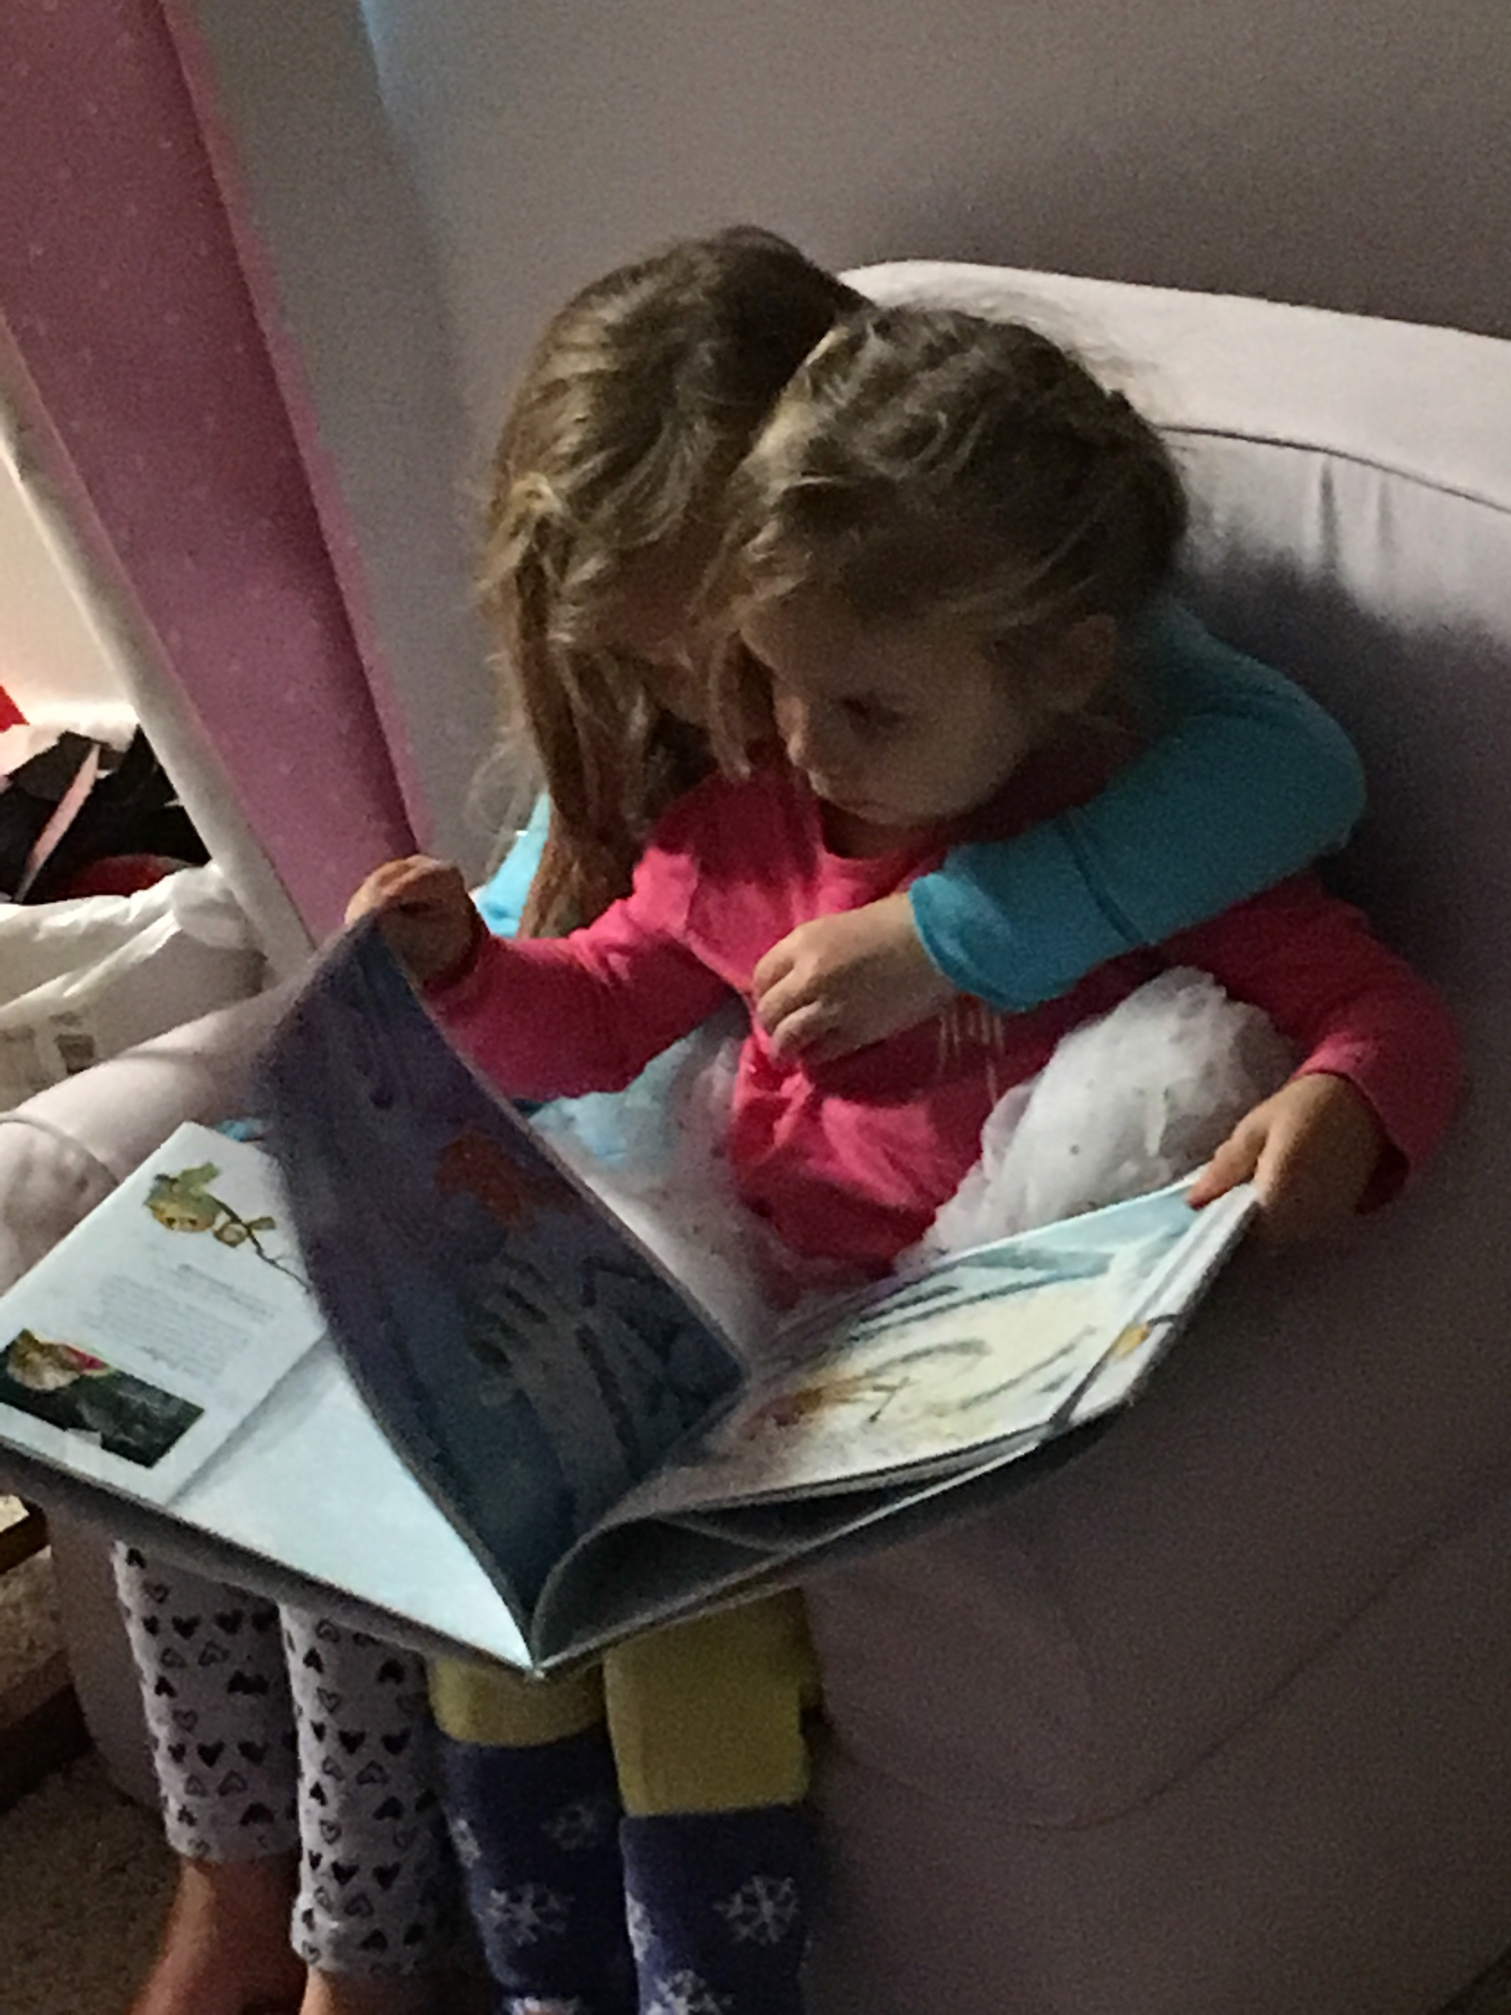
A picture!
This is some text with a picture on the right. Those are my two girls. They’re the cutest.

Slide 4


Two pictures in one slide
This slide has some text and two pictures. It still works

Slide 5



Lots of pictures!
If we have more than two pictures, it starts to not work very well, so it defaults to putting them all on their own slides as background images.

Slide 6
A Table
Variable | Coefficient | Standard Error
Intercept | 250.57 | 0.78
height | 10.4 | 2.53
weight | 8.7 | 6.89
age | 0.50 | 0.04

Slide 7
Bold and italics
Here’s some bold text and here’s some italicized text on the same line
But yet… It parses them both, even when they’re bold and italicized!!!

Slide 8
Links
Links are preserved as well. For example, you can see a link to the development version of this package here.

Slide 9
Line Plot!

Slide 10
Bar Plot

Slide 11

Histogram

Slide 12
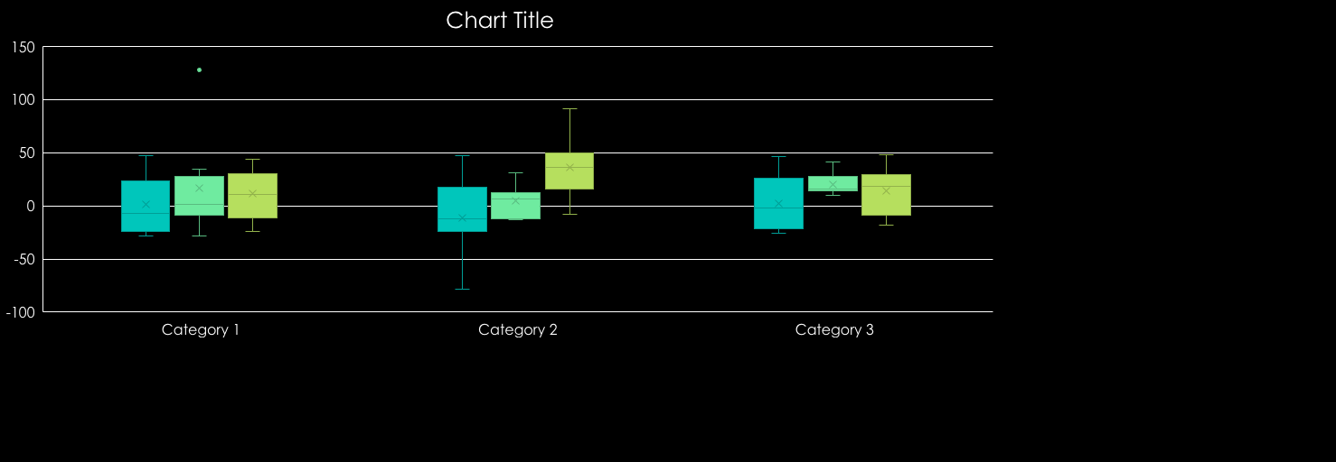
Box Plot

Slide 13
A brilliant flow chart
Have fun
Love life
Work hard

Slide 14
Two-Panel Layout
Content on the left
And content on the right

Slide 15
That’s all for now
Thanks for your interest!

